Slide 1

Who is going to buy the new vehicle insurance?
IDS 702 Final Project Presentation
by
Sutianyi Wen

Slide 2
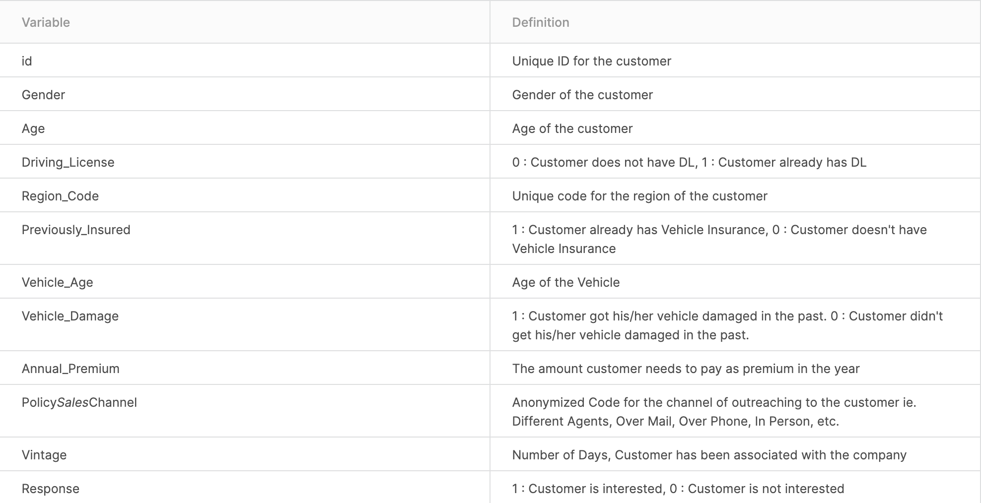

Slide 3

Background Information
The sales team wants to know:
Will old customers who are associated with company for a long time(>150 days) be more likely to purchase the vehicle insurance?
Are older people more likely to be interested buying car insurance than younger people?
Does customers’ interest of buying the vehicle insurance differ by region and sales channel?

Slide 4
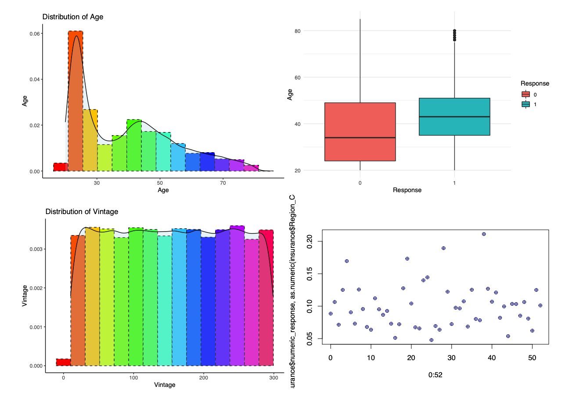
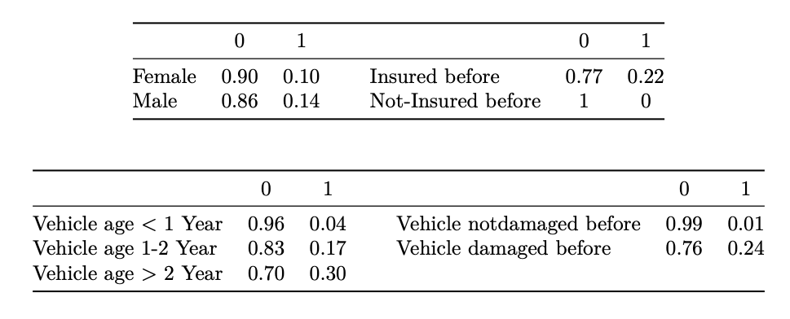
Data Processing & EDA
Dataset Description: 381,109 entries & 11 variables & 1 binary response variable
A subset with 33% of original size is created via random sampling
We might need to bin up Age and Vintage to let the hierarchical model run

Slide 5
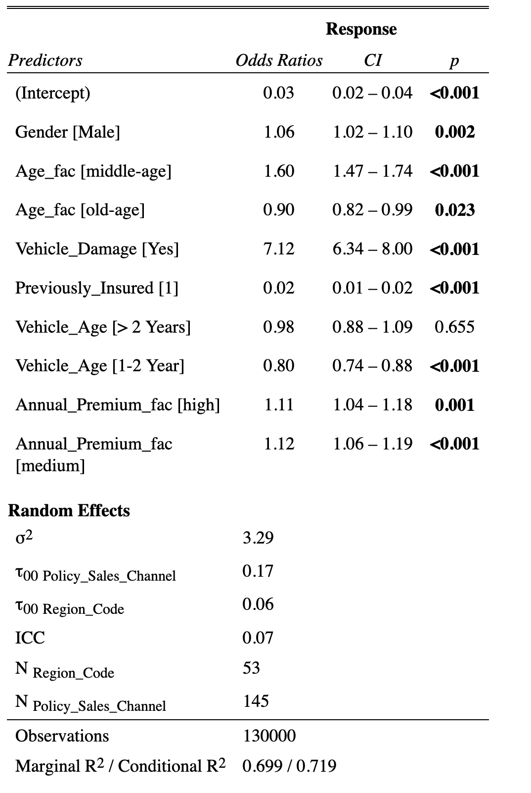
Model Development & Validation
Response ~ Gender + Age_fac + Vehicle_Damage + Previously_Insured + Vehicle_Age + Annual_Premium_fac + (1 | Region_Code) +
(1 | Policy_Sales_Channel)

Slide 6
Model Result
Customers’ interests in buying a car insurance vary across region and sales channel:
The random effects of sales channel have a variance of 0.17
The random effects of region have a variance of 0.06
All predictors from final model are statistically significant:
Holding every other variables the same, the male customers are 6% more likely to be interested in buying the vehicle insurance compared to female customers
Holding everything else the same, a customer with age between 30 and 50 is 60% more likely to be interested in buying the vehicle insurance than a customer with age less than 30
With everything else staying the same, if a customer already had a vehicle insurance, he/she is 98% less likely to be interested in buying vehicle insurance compared to customer who is not insured with cars.
It turns out how many days a customer associated with the company before is not statistically significant

Slide 7

Conclusion
The Number of Days, Customer has been associated with the company is not statistically significant to tell whether a customer will be interested in buying the vehicle insurance.
Customers with age between 30 to 50 appears to be more interested in buying the car insurance given other variables staying the same compared other groups.
Customers’ interest of purchasing vehicle insurance vary by region and sales channel
Some interesting finding:
Customers who already had vehicle insured are rarely interested buying another insurance from the company.
Male tends to be more interested in vehicle insurance than female.

